Slide 1
Cohen chap 4. standard & normal
“How do all these unusuals strike you, Watson?”
“Their cumulative effect is certainly considerable, and yet each of them is quite possible in itself”
Sherlock Holmes and Dr. Watson
The Adventure of Abbey Grange
For EDUC/PSY 6600

Slide 2
Exploring Quantitative Data
We now have a kit of graphical and numerical tools for describing distributions. We also have a strategy for exploring data on a single quantitative variable. Now, we’ll add one more step to the strategy.
Exploring Quantitative Data
Always plot your data: make a graph.
Look for the overall pattern (shape, center, and spread) and for striking departures such as outliers.
Calculate a numerical summary to briefly describe center and spread.
Sometimes the overall pattern of a large number of observations is so regular that we can describe it by a smooth curve.

Slide 3
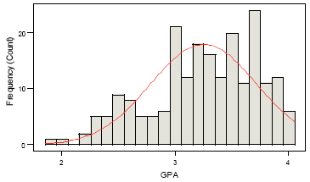
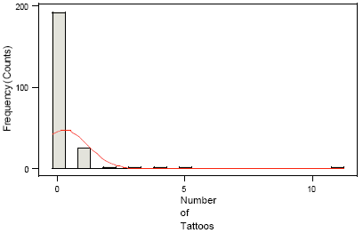
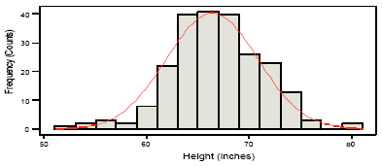
Density Curves & Normal Distributions
Heights (inches)
Mean = 66.3 inches
Median = 66 inches
GPA
Mean = 3.25
Median = 3.3
Number of Tattoos
Mean = .23
Median = 0

Slide 4
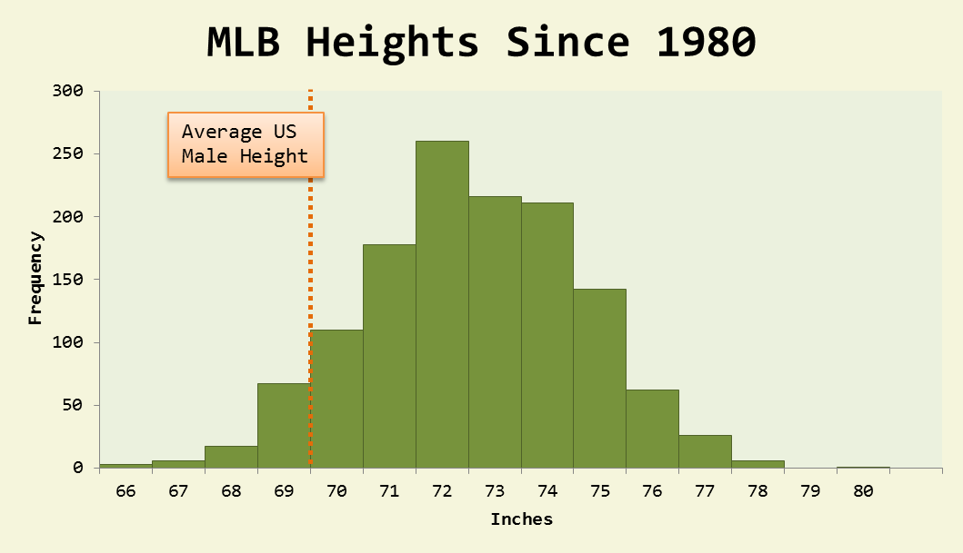
Density Curves & Normal Distributions
A density curve is a curve that:
is always on or above the horizontal axis
has an area of exactly 1 underneath it
A density curve describes the overall pattern of a distribution. The area under the curve and above any range of values on the horizontal axis is the proportion of all observations that fall in that range.

Slide 5
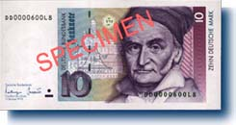
Normal distribution
Many dependent variables are assumed normally distributed
Use statistical procedures where data are assumed normally distributed
Correlation, regression, t-tests, and ANOVA
Gaussian distribution
Karl Gauss

Slide 6
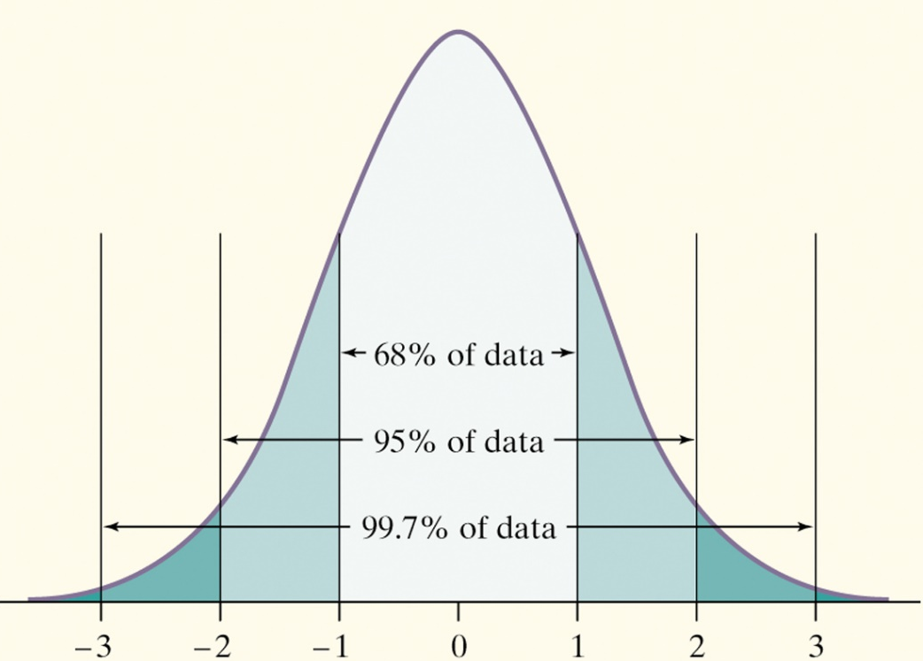
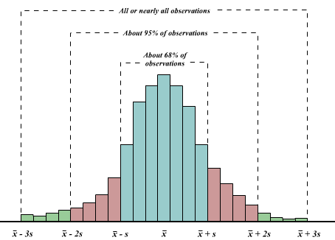
The 68-95-99.7 Rule
In the Normal distribution with mean µ and standard deviation σ:
Approximately 68% of the observations fall within σ of µ.
Approximately 95% of the observations fall within 2σ of µ.
Approximately 99.7% of the observations fall within 3σ of µ.

Slide 7
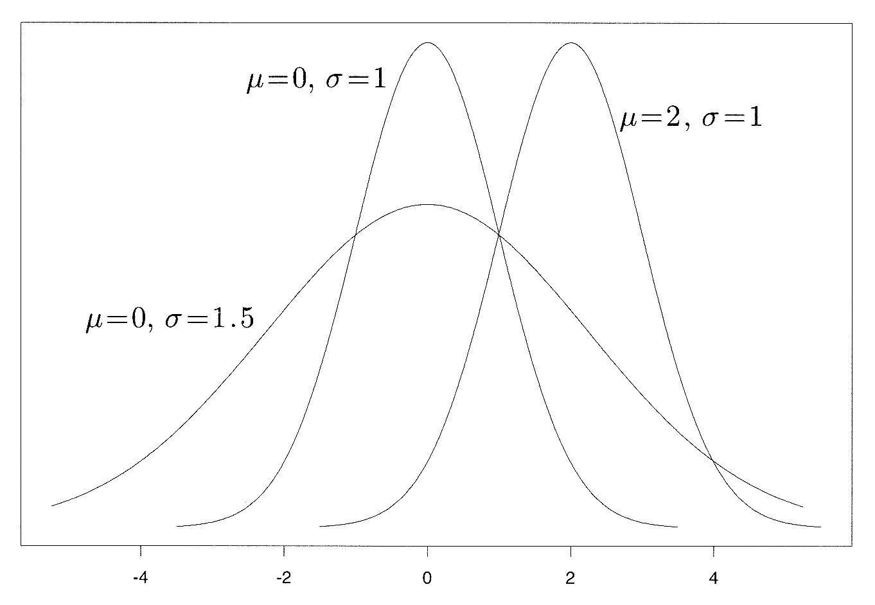
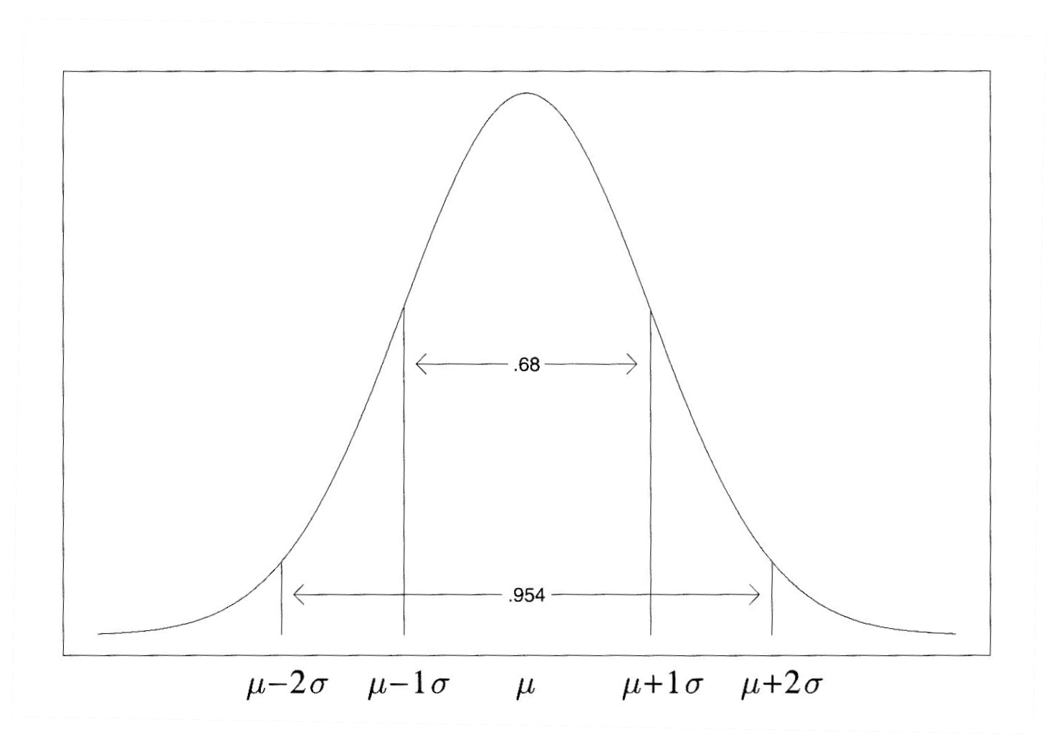
Normal distributionS
Each μ and σ combination produces differently shaped normal distribution
Family of distributions
Probability generating function for normal distribution:
If we know μ and σ for given variable in given population we can, for given value of X, compute the density (frequency) of that value and thus determine its probability
No matter the exact shape, the properties in terms of area under the curve per SD unit are the same!

Slide 8
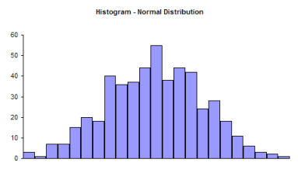
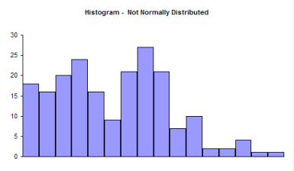
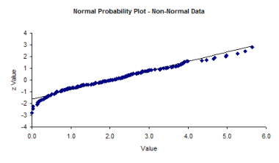
Density Curves & Normal Distributions
How can you tell if the data is normally distributed? A Q-Q plot!
Normally distributed data will have all a Q-Q plots with the dots all in a straight line

Slide 9
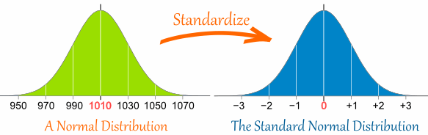
Z-scores
z-scores are in SD units
Represent SD distances
away from M ( = 0)
z-score = -0.50 → ½ SD below M
Can compare z-scores from 2 or more variables originally measured in differing units
So to convert a value to a Standard Score ("z-score"):
first subtract the mean,
then divide by the Standard Deviation
And doing that is called "Standardizing":
Standardizing does NOT “normalize” data

Slide 10
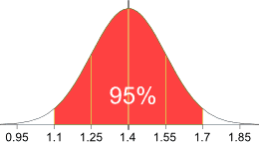
Example: draw a picture
95% of students at school are between 1.1m and 1.7m tall
Assuming this data is normally distributed can you calculate the mean and standard deviation?
The mean is halfway between 1.1m and 1.7m:
Mean = (1.1m + 1.7m) / 2 = 1.4m
95% is 2 standard deviations either side of the mean (a total of 4 standard deviations) so:
standard deviation = (1.7m-1.1m) / 4 = 0.6m / 4 = 0.15m

Slide 11
EXAMPLE: calculate z-score
You have a friend who is 1.85m tall
How far is 1.85 from the mean?
It is 1.85 - 1.4 = 0.45m from the mean
How many standard deviations is that?
0.45m / 0.15m = 3 standard deviations
You can see on the bell curve that 1.85m is 3 standard deviations from the mean of 1.4, so:
Your friend's height has a "z-score" of 3.0

Slide 12
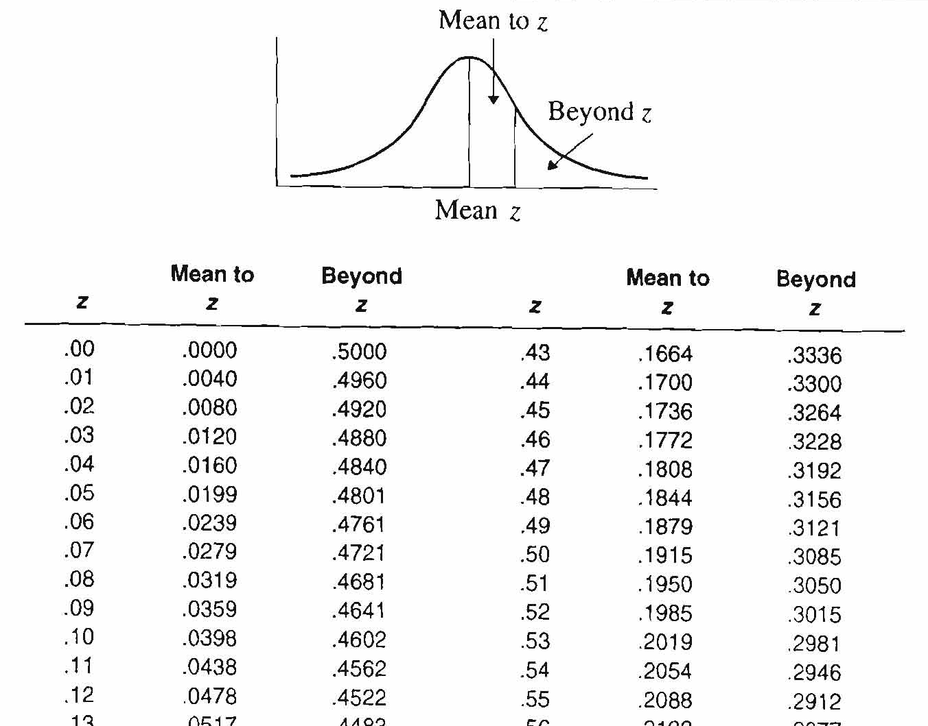
Using z-scores in the table
Statistical texts: z or standard normal distribution table
Only ½ distribution presented in table (symmetrical)
Add negative sign for z-scores below M
z-scores used to determine area under curve
Between given z-score and M (0)
Between given z-score and tail of distribution
Between 2 z-scores

Slide 13
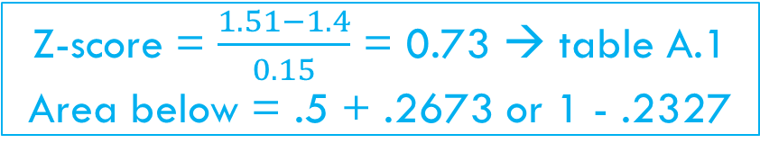

Examples: standardizing scores
Assume: School’s population of student’s heights have M (µ) = 1.4 m & SD (σ) = 0.15 m
$$\frac{1.63−1.4}{0.15}$$
The z-score for student 1.63 m tall = ______
Height of student with a z-score of -2.65 = _______
The PR of a student that is 1.51 m tall = _______
The 90th percentile for student heights = _______
1.53 SDs
1.00 m
1.4 - 2.65(0.15)
Z-score = $\frac{1.51−1.4}{0.15}$ = 0.73 → table A.1
Area below = .5 + .2673 or 1 - .2327
76.73
Area below = .9 → table A.1= .40 & .10
Z-score = 1.28
Height = 1.4 + 1.28*0.15
1.59 m

Slide 14
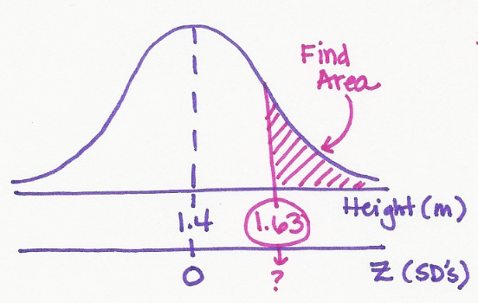
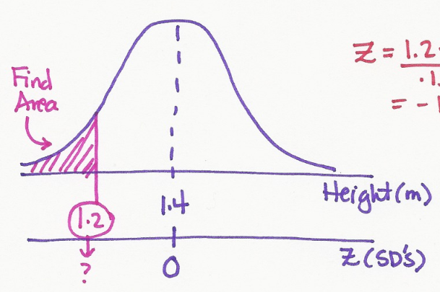
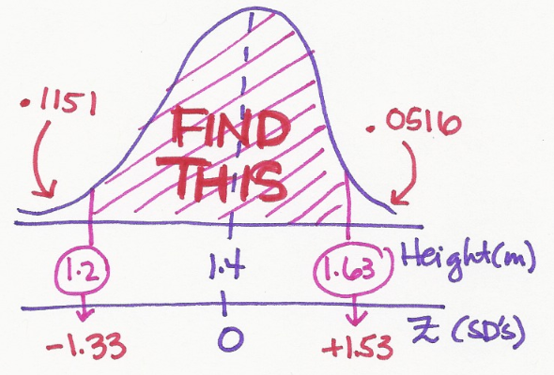

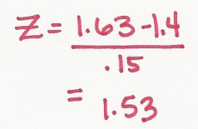
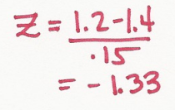
Examples: finding probabilities
Assume: School’s population of student’s heights have M (µ) = 1.4 m & SD (σ) = 0.15 m
Probability a randomly chosen student is…
more than 1.63 m tall
less than 1.2 m tall
between 1.2 & 1.63 m tall
.0516
.1151
1- .0516 - .1151
.8333

Slide 15
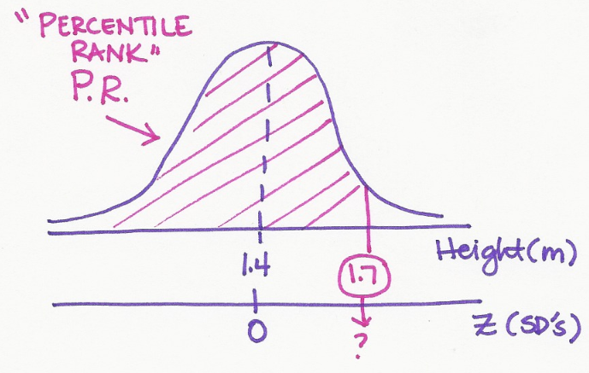
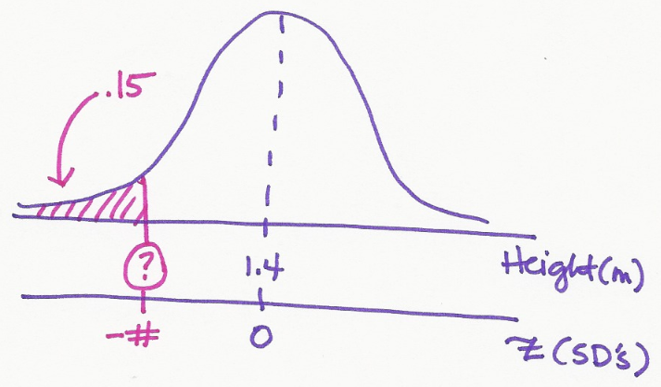
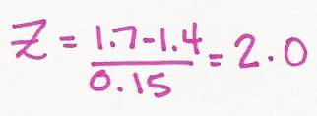
Examples: using percentiles
Assume: School’s population of student’s heights have M (µ) = 1.4 m & SD (σ) = 0.15 m
What is the Percentile Rank (PR) for a student with a height of 1.7 m?
What height correspond to the 15 percentile in student height?
Table: z = -1.04
Table: tail = .0228
Height = 1.4 -1.04(0.15)
97.72th
1.24 meters

Slide 16
Other normal distributions
Which one? Convention and tradition
Name & formula | µ | σ
SAT = 100z + 500 | 500 | 100
T = 10z + 50 | 50 | 10
IQ: Standford-Binet = 16z + 100 | 100 | 16
IQ: Wechsler = 15z + 100 | 100 | 15

Slide 17
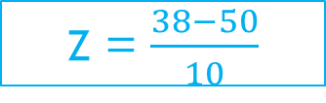
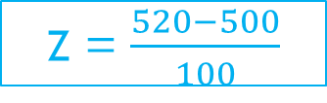
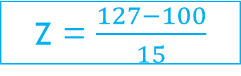
Examples: convert scores
480
SAT = 500 + -0.2(100)
Z = -0.2 → _____ SAT score
SAT = 520 → _____ z score
Z = 1.3 → _____ T score
T-score = 38 → _____ z score
Z = -3.1 → _____ W-IQ score
W-IQ = 127 → _____ z score
Z = $\frac{520−500}{100}$
0.20
SAT = 50 + 1.3(10)
63
Z = $\frac{38−50}{10}$
-1.20
47.5
SAT = 100 -3.1(15)
1.80
Z = $\frac{127−100}{15}$

Slide 18
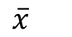
Parameters & statistics
Population
“parameters”
N = size
μ = mean
σ² = variance
σ = standard deviation
Sample
“statistics”
n = size
= mean
s² = variance
s = standard deviation
$$\overline{x}$$

Slide 19

Example: sleep
Implies for the entire population
A recent survey describes the distribution of total sleep time among college students as approximately Normal with a mean of 7.02 hours and standard deviation of 1.15 hours.
Select a college student at random and obtain his or her sleep time. The result is a random variable X. Prior to the random sampling, we don’t know the sleep time of the chosen college student, but we do know that in repeated sampling X will have the same N(7.02, 1.15) distribution that describes the pattern of sleep time in the entire population. We call N(7.02, 1.15) the population distribution.
μ
σ
N ( ___ , ___ ) means the distribution is NORMALLY distributed, with MEAN ___ and STANDARD DEVIATION ___
μ
σ

Slide 20
Statistical estimation
The process of statistical inference involves using information from a sample to draw conclusions about a wider population.
Different random samples yield different statistics. We need to be able to describe the sampling distribution of possible statistic values in order to perform statistical inference.
We can think of a statistic as a random variable because it takes numerical values that describe the outcomes of the random sampling process.
Population
Sample
Collect data from a representative Sample...
Make an Inference about the Population.

Slide 21
Sampling distribution
The law of large numbers assures us that if we measure enough subjects, the statistic x-bar will eventually get very close to the unknown parameter µ.
If we took every one of the possible samples of a certain size, calculated the sample mean for each, and graphed all of those values, we’d have a sampling distribution.
“Population Distribution” (raw data)
Shows ALL values for all
Individuals in the population
“Sampling Distribution”
Shows all values taken by the statistic,
in all possible samples of the same size
Sa

Slide 22
Sampling distribution for the MEAN
Mean of a sampling distribution of a sample mean: just as likely to be above or below μ, even if the distribution of the raw data is skewed.
Standard deviation of a sampling distribution of a sample mean: is smaller than the standard deviation of the population by a factor of √n.
➔ Averages are less variable than individual observations!
IF
individual observations
Mean µ_{x} &
Standard Deviation σ_{x}
SRS size n
THEN
sample mean
Mean µ_{X-bar} = µ_{X} &
Standard Deviation σ_{X-bar} = σ_{X} /√n

Slide 23

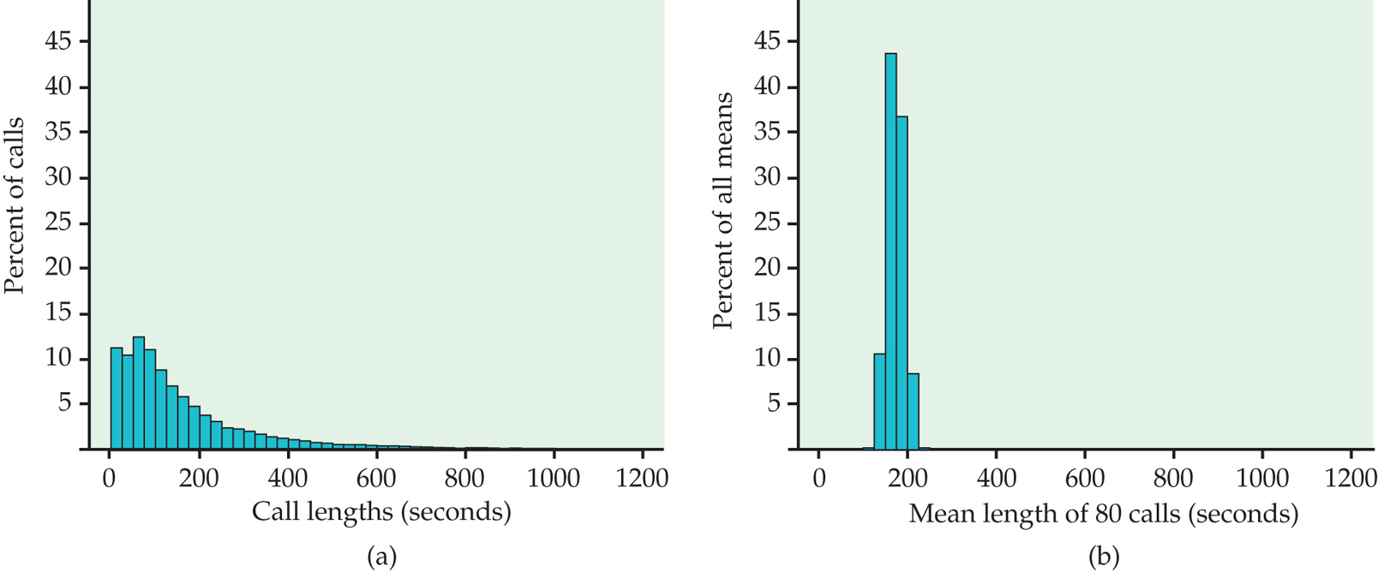
EXAMPLE: bank calls
(b) The distribution of the sample means x-bar for 500 random samples of size 80 from this population. The scales and histogram classes are exactly the same in both panels
(a) The distribution of lengths of all customer service calls received by a bank in a month.
X = Raw data for ALL calls
X-bar = AVERAGE for 80
More normal
Right-skewed

Slide 24
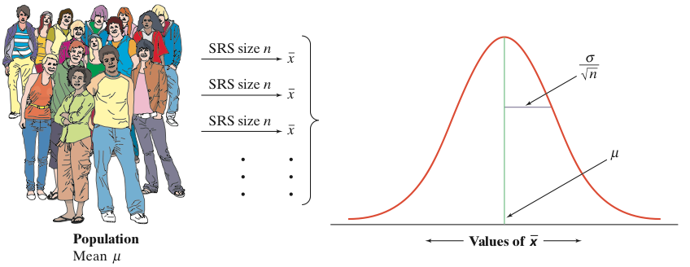
Sampling distribution for the MEAN
What if the population distribution was NORMAL?
What if the population distribution is NOT normal, or even discrete?
IF
individual observations
have the
N(µ,σ) distribution
THEN
the sample mean of an SRS of size n has the N(µ, σ/√n) distribution
“SE”
Standard error
SE for mean = SD divided by square root of the sample size

Slide 25

Example: bank calls
X = Raw data for ALL calls
X-bar = AVERAGE for 80
More normal
Right-skewed
The standard deviation of the population of service call lengths is σ _{x} = 184.81 sec.
The length of a single call will often be far from the population mean.
What is the standard deviation for a SRS sample of 80 calls?
If we choose an SRS of 20 calls, the standard deviation of their mean length is…
SE for mean = σ_{x-bar} = σ_{x} /√n = 184.81 /√80 = 20.66
SE for mean = σ_{x-bar} = σ_{x} /√n = 184.81 /√20 = 41.32

Slide 26
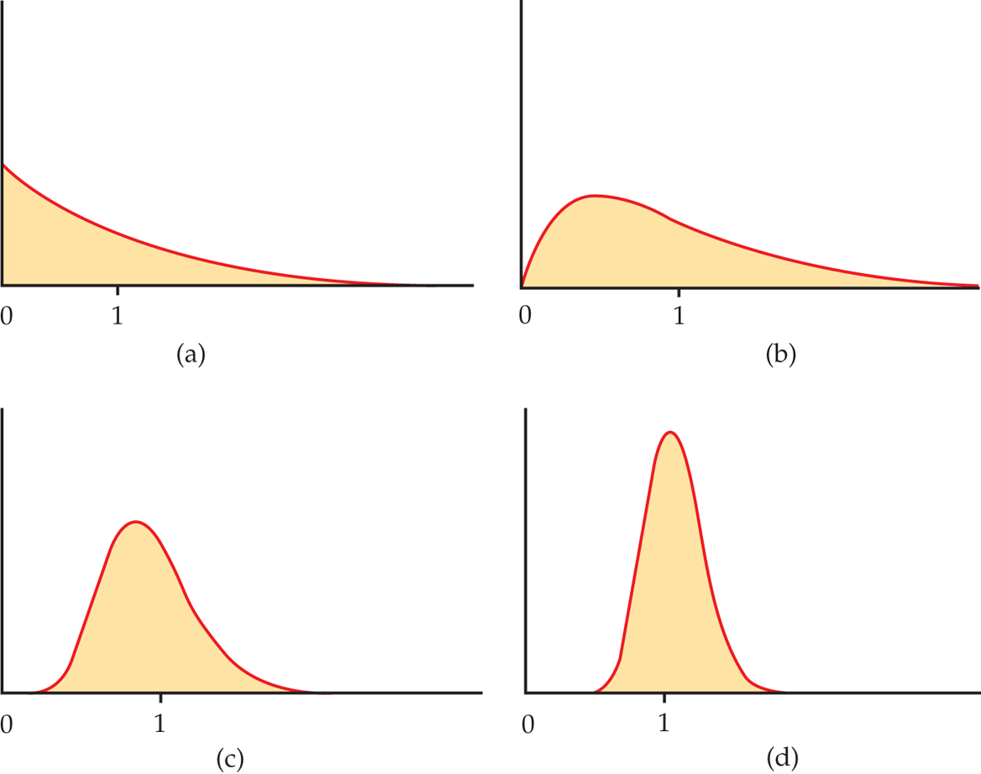
The central limit theorem
Population Distribution
(sample size 1)
Sampling Distribution
for MEAN of a sample size 2
Sampling Distribution
for MEAN of a sample size 10
Sampling Distribution
for MEAN of a sample size 10

Slide 27
Examples: finding probabilities
Assume: School’s population of student’s heights have M (µ) = 1.4 m & SD (σ) = 0.15 m
Probability the height of
a randomly chosen student is…
Probability the MEAN of
a randomly chosen GROUP of 16 students is…
more than 1.63 m tall
more than 1.63 m tall

Slide 28
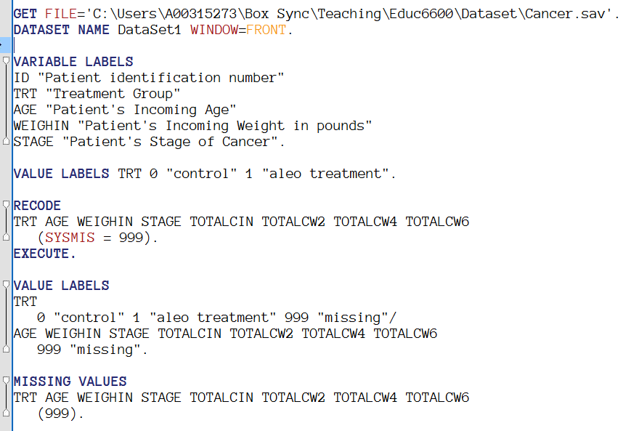
Example: cancer dataset
Available on Canvas
Save to your computer
Edit the path to match

Slide 29
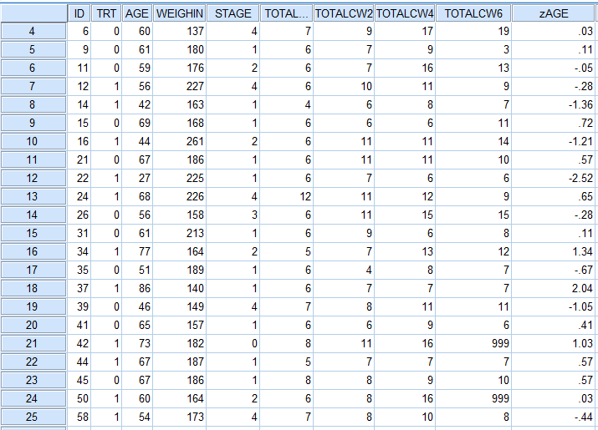
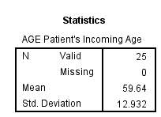
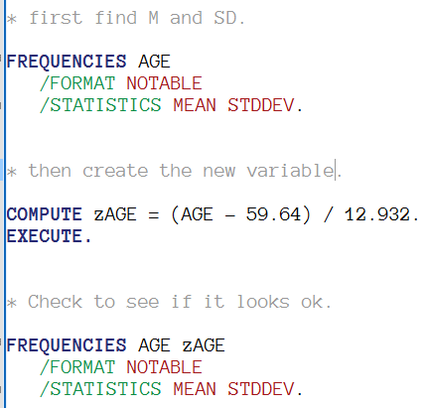
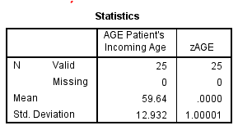
SPSS: create a z-score variable

Slide 30
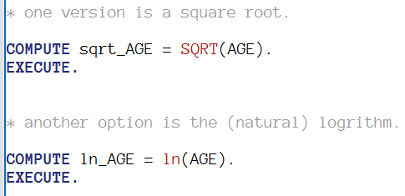
SPSS: transforming variables
* This is useful IF you have a variable that is POSITIVELY SKEWED, since the methods we will learn all require your variables are NORMALLY distributed.

